Slide 1


Personal Financial Management
Supervisor: Mr. Nguyễn Văn Hiển
Team member:
1. Lại Lê Lệ Linh
2. Nguyễn Thị Gấm
3. Lê Thị Minh Khánh
4. Nguyễn Đức Lộc
5. Nguyễn Anh Tuấn

Slide 2

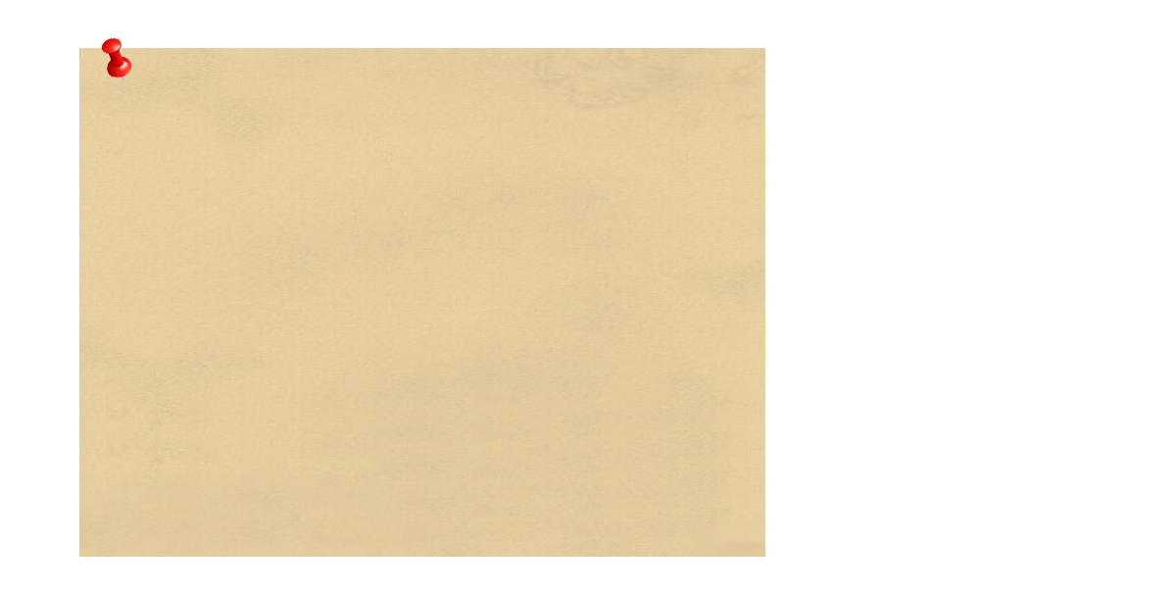
Content
Introduction
Project Management Plan
Requirement Specification
Design Description
Implementation
Test Document
Summary
Demo and Q&A

Slide 3
Introduction
The people
Initial idea
Overview of existing systems
Our proposal

Slide 4
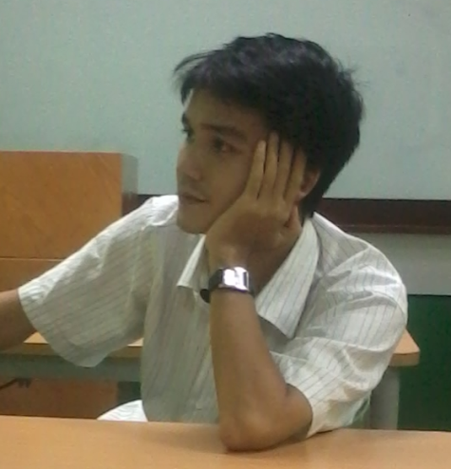

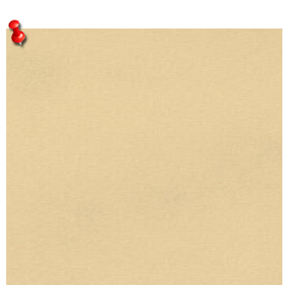

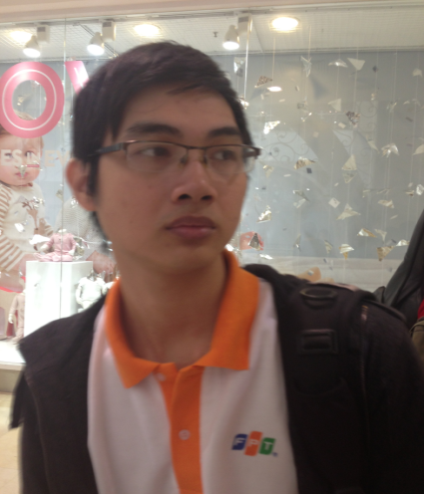

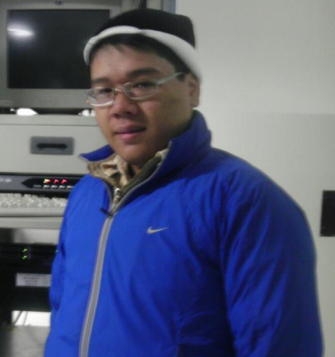
Lại Lê Lệ Linh
The people
Project Leader
Tester
Designer
Instructor
Tester
Mr. Nguyễn Văn Hiển
Lê Thị Minh Khánh
Technical Leader
Developer
Tester
Developer
Nguyễn Đức Lộc
Nguyễn Thị Gấm
Nguyễn Anh Tuấn

Slide 5


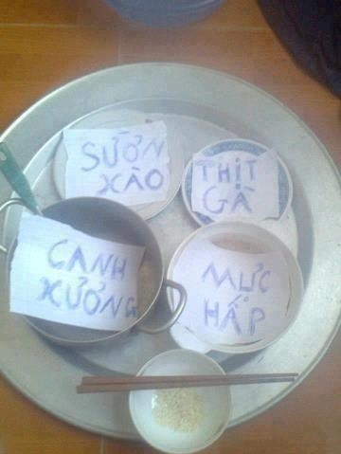

Initial Idea
Some people can not manage their money
Notes:
Tại sao ko quản lý đc
Ví dụ
Dẫn chứng một số ứng dụng đã có và không đáp ứng đc nhu cầu

Slide 6



Overview of existing systems
Money Lover
CWMoney
Easy Money

Slide 7
Overview – Money Lover
1
Difficult to access application
2
Not user - friendly
3
No synchronization between different units
Money Lover
Notes:
Lúc mới vào app phải seetting ngôn ngữ và account

Slide 8
Overview - CWMoney
1
Not support Vietnamese
2
Not enough function to manage finance
3
Difficult to use
CWMoney

Slide 9

Overview – Easy Money
1
Lost data
2
Must buy to use
3
Very confuse
Easy Money

Slide 10

Our proposal
Interface
User- friendly
Functions
Schedule
Elegant
Income and Expense Management
Borrowing and Lending
Warning, Synchronize
Import & Export
Use Vietnamese

Slide 11
Project Management Plan
Development Environment
Process
Project Organization
Project Plan

Slide 12

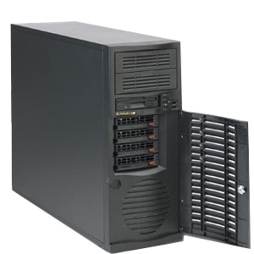
Development Environment
Development Hardware
3 Gb of RAM
Server Hardware
300Gb of hard disk
Core i4 Duo 2.0 Ghz

Slide 13







Development Environment

Slide 14
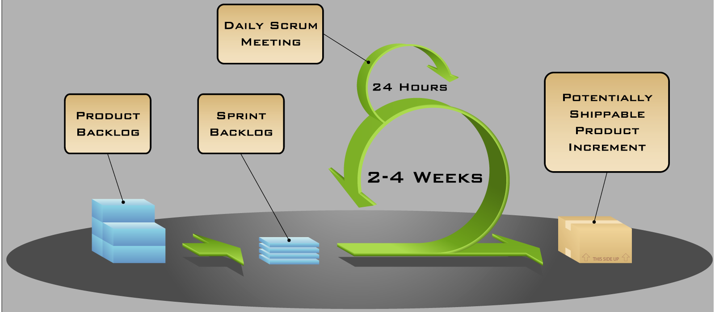
Process
Follow Scrum Model

Slide 15
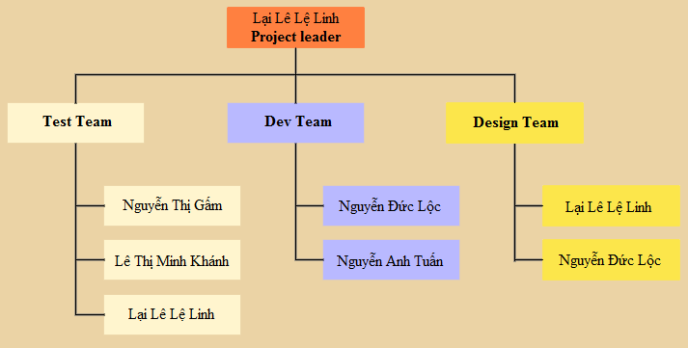
Project Organization

Slide 16
Project Plan
PFM
Communication
Meeting, Email, Skype, Hangout…
Time
Follow Capstone Project Requirements
Buffer: 10 days
Weekly Meeting
Checking progress
Require: Instructor and all team members.
Data
Upload and download all project document from SVN: https://piem2012.googlecode.com/svns

Slide 17
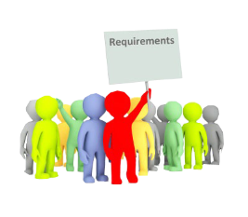
Software Requirement Specification
User Requirement
Non- functional Requirement

Slide 18
User Requirement
Management
Record all transactions (expense, income…)
Edit all transactions, warnings…
Setup warning
Track
View all transactions, warnings…
View statistics report
Synchronize data

Slide 19


Non-functional Requirement
GUI: elegant, simple, outstanding
Availability
Run 24/7
Portability
Have work on Android 2.3 and higher
Usability
Maintainability
Performance
Easy to install
Following coding standard and naming convention
Loading time: 1 second

Slide 20
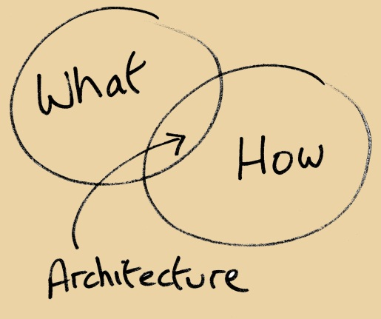

Software Design Description
Architectural Design
Detailed Design
Database Design

Slide 21
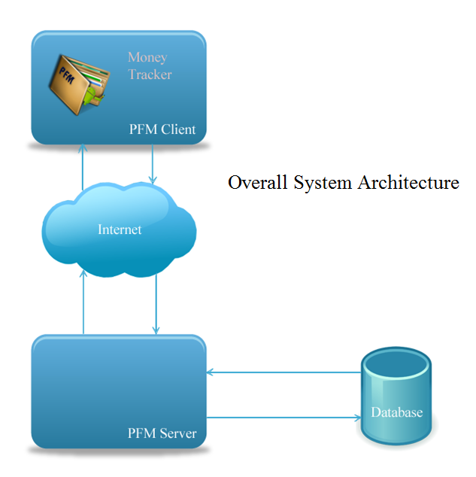
Architectural Design

Slide 22
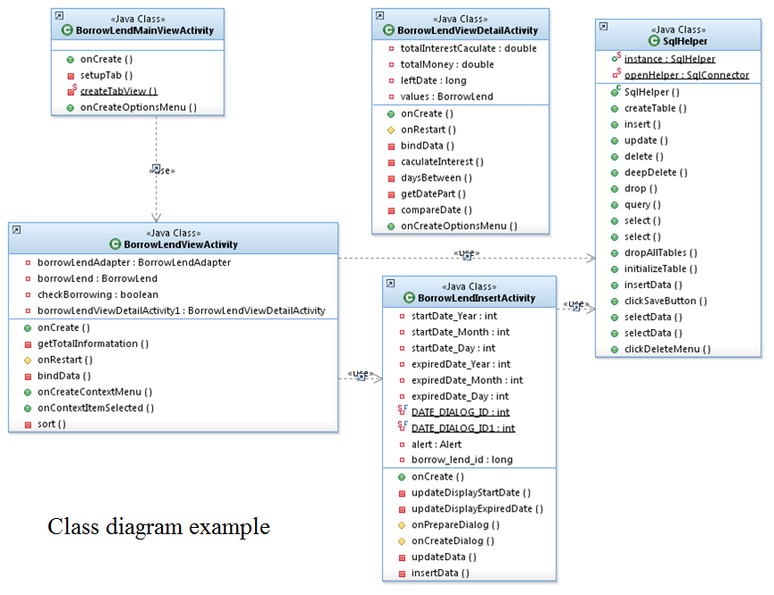
Detailed Design

Slide 23
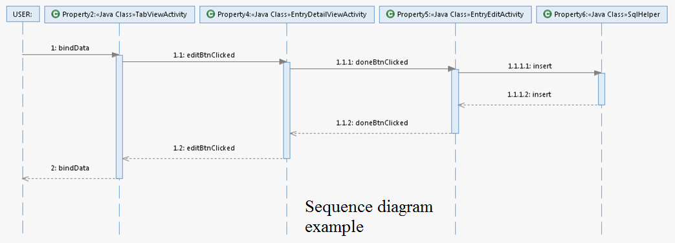
Detailed Design

Slide 24
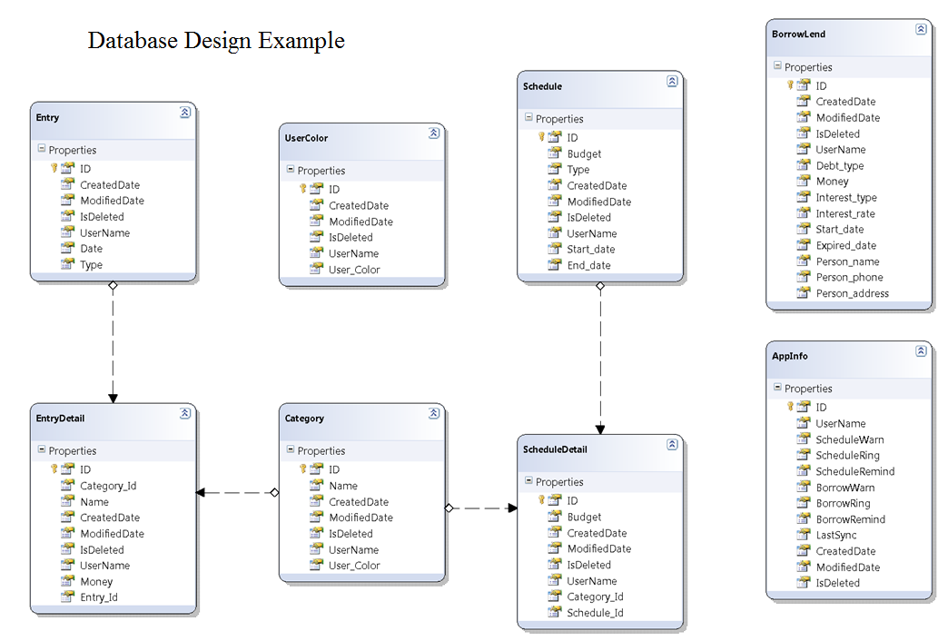
Database Design

Slide 25
Technology Solution
Near Field Communication(NFC)
Synchronization
Quick Response Code

Slide 26

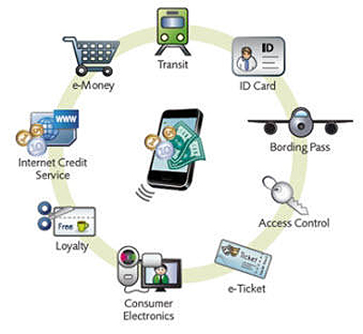
Near Field Communication (NFC)
A set of standards to establish radio communication
A set of standards to establish radio communication

Slide 27
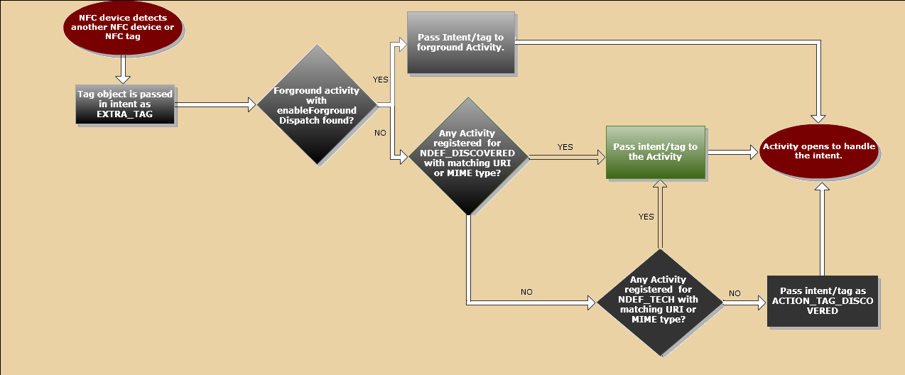
Near Field Communication (NFC)

Slide 28
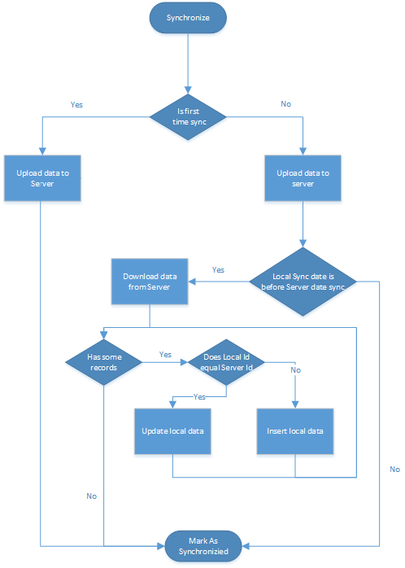
Synchronization
Synchronize all user’s data with an existed email account
Synchronize data with multi-account
Synchronize data to multi-device
Automatically synchronization mode

Slide 29
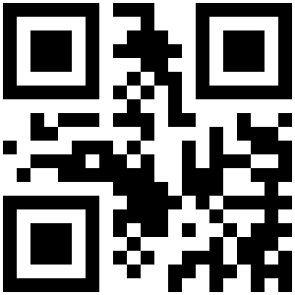
Quick Response Code (QR Code)
What is QR Code?
the trademark for a type of matrix barcode
invented in Japan by the Toyota subsidiary Denso Wave in 1994

Slide 30
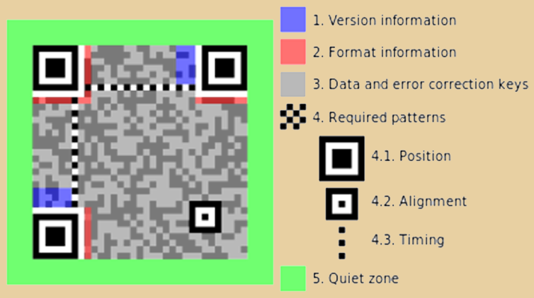

Quick Response Code (QR Code)
Structure of QR Code symbol
■ Encoded data (including error correct code) ■ Format information

Slide 31
Quick Response Code (QR Code)
ZXing in Money Tracker
Image Conversation
QR Detector
QR Decoder

Slide 32
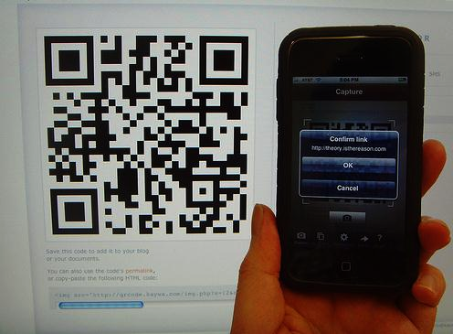
Zxing in Money Tracker
Image Conversation
ZXing will use camera of the device to capture the QR Code

Slide 33
Zxing in Money Tracker
2. QR Detector
for (long i = 0; i < dimension; ++i) { for (long j = 0; j < dimension; ++j) { POINT pt; pt.x = (j * module_size) + half_module_size; pt.y = (i * module_size) + half_module_size; POINT p = transform.TransformPoint(pt); qr_store.set(pt, image.IS_BLACK(p)); } }

Slide 34
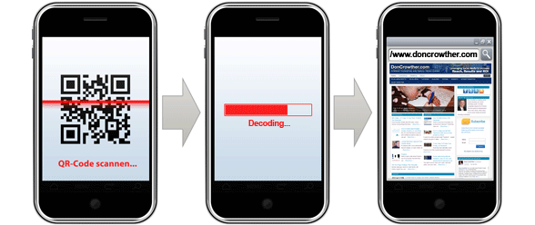
Zxing in Money Tracker
3. QR Decode

Slide 35
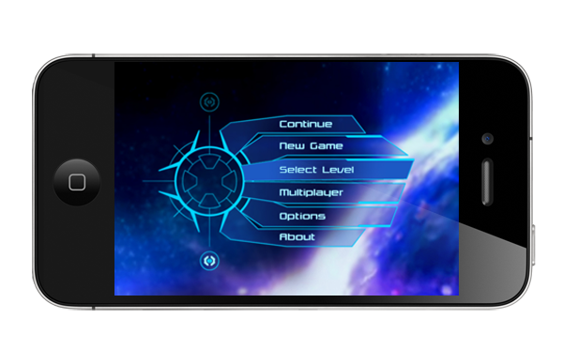
Software Test Document
Feature to be tested:
User Interface
Functional

Slide 36
Test Report
 | Pass | Fail | Untested | Accepted | N/A | Number of Test cases
Test Pass 1 | 98 | 47 | 0 | 0 | 0 | 145
Function-Use case | 60 | 46 | 0 | 0 | 0 | 106
GUI | 32 | 0 | 0 | 0 | 0 | 32
Common | 6 | 1 | 0 | 0 | 0 | 7
Test coverage
Test coverage |  |  |  |  |  | 100.00%
Test successful coverage |  |  |  |  |  | 67.58%

Slide 37
Test Report
 | Pass | Fail | Untested | Accepted | N/A | Number of Test cases
Test Pass 2 | 145 | 0 | 0 | 0 | 0 | 145
Function-Use case | 106 | 0 | 0 | 0 | 0 | 106
GUI | 32 | 0 | 0 | 0 | 0 | 32
Common | 7 | 0 | 0 | 0 | 0 | 7
Test coverage
Test coverage |  |  |  |  |  | 100.00%
Test successful coverage |  |  |  |  |  | 100.00%

Slide 38



Lesson Learnt
Improved working in group, presentation, communication skill
Work well under higher pressure
More work experience with tools and technic like: android, photoshop, NFC…

Slide 39

Thank for Listening

Slide 40
Demo

Slide 41
Q&A

